Slide 1
General Guidelines for Presentation
Slides should not be too heavy with content. Better to create point wise.
If you require more than one slide for any point, right click on that point slide then select duplicate slide and modify the duplicated slide.
Diagrams must be aligned at centre and clearly visible with caption.
All the mentioned fonts, font size, title content, etc should not change and strictly as per the given format and guidelines.

Slide 2

Project name:-APSIT CONNECT
Student Name:-Aryan salunke(24107115)
Kartik Nair(23107123)
Siddhant Tidke(23107083)
Gautam Mandal(24107109)
Project Guide
Ms.Ujwala Pagare

Slide 3
Contents
Introduction
Objectives
Scope
Features / Functionality
Project Outcomes
Technology Stack
Block Diagram if applicable

Slide 4
1. Introduction
Problem Identified :
Students often face difficulty accessing academic materials like notes, assignment
and project files from a single platform.
Communication between students and faculty for doubt solving is limited and not
organized.
Solution Proposed :
APSIT Connect is a centralized platform where students can upload and download academic resources easily.
It also provides a discussion forum where students can ask doubts and receive guidance from faculty members.

Slide 5
2. Objectives
1.To build a login and registration system so only verified students can access the platform
2.To develop a module where students can upload and download academic materials like notes, assignments, and project files.
3.To implement subject-wise and year-wise organization of academic content for easy searching.
4.To create a discussion section where students can ask doubts and get guidance from faculty.

Slide 6
3. Scope
Can be applied in colleges for academic resource sharing.
2. Useful for students and faculty for knowledge exchange.
3. Can be used for assignment and project collaboration.
4. Can improve academic communication.

Slide 7
4. Feature /Functionality
Feature 1: Login System Allows users to log in using email and password with role selection (Student or Teacher) for secure access.
Feature 2: Role-Based Dashboard Displays a dashboard with modules such as Attendance, Notes, Discussion, and Assignments according to the user role.
Feature 3: Attendance Module Provides a section where students can view attendance and teachers can manage attendance records.
Feature 4: Discussion Module Provides a platform where students can ask doubts and teachers can respond.

Slide 8
SDGs as per the UN framework, which NBA institutions typically align their programs to:
SDG 4 – Quality Education
APSIT Connect improves access to academic resources like notes, assignments, and discussions on a single platform.
It enhances learning efficiency and student–faculty interaction, leading to better academic outcomes.
SDG 9 – Industry, Innovation and Infrastructure
The project provides a digital academic infrastructure for managing and sharing educational content efficiently.
It promotes innovation by replacing traditional, unorganized communication with a structured platform.

Slide 9
SDG 10 – Reduced Inequalities
Ensures equal access to study materials and academic support for all students.
Reduces dependency on informal sources, minimizing gaps between students.
SDG 11 – Sustainable Cities and Communities
Encourages digital sharing of resources, reducing reliance on paper and physical distribution.
Supports a more organized and connected academic environment within the institution.

Slide 10
5. Outcome of Project
Centralized Academic Resource Platform: A fully functional web/mobile platform where students can upload and download notes, assignments, and project files in a subject-wise and year-wise organized manner.
Secure Role-Based Access: Implemented a login and registration system with role-based authentication, ensuring only verified students and teachers can access their respective dashboards and features.
Interactive Discussion Forum: Created a structured discussion module enabling students to post academic doubts and receive prompt responses from faculty, improving communication and knowledge exchange.
Attendance Management: Developed an attendance module where teachers can manage records and students can view their attendance, enhancing academic accountability.
Cross-College Scalability: The platform is designed to be scalable and applicable across multiple colleges, supporting academic collaboration, resource sharing, and improved student-faculty interaction.

Slide 11
.
6. Technology Stack
Frontend -Flutter Framework, Dart Programming Language
Material Design (Material UI), GridView Layout
2. Backend - Local In-Memory Database (Map in Dart)
Role-Based Authentication, Data Handling using Dart

Slide 12
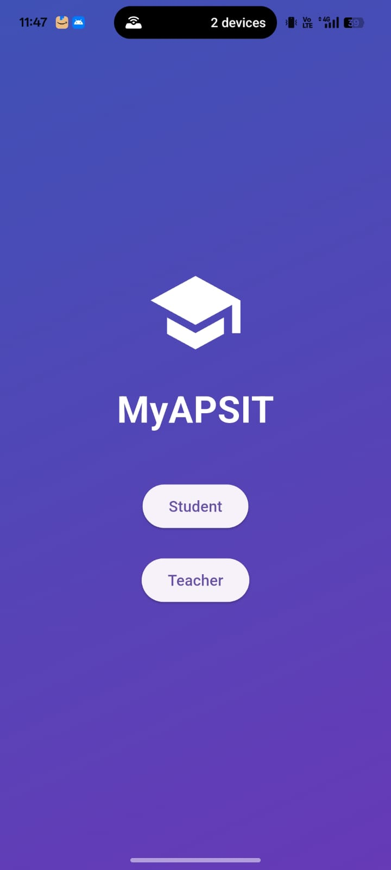
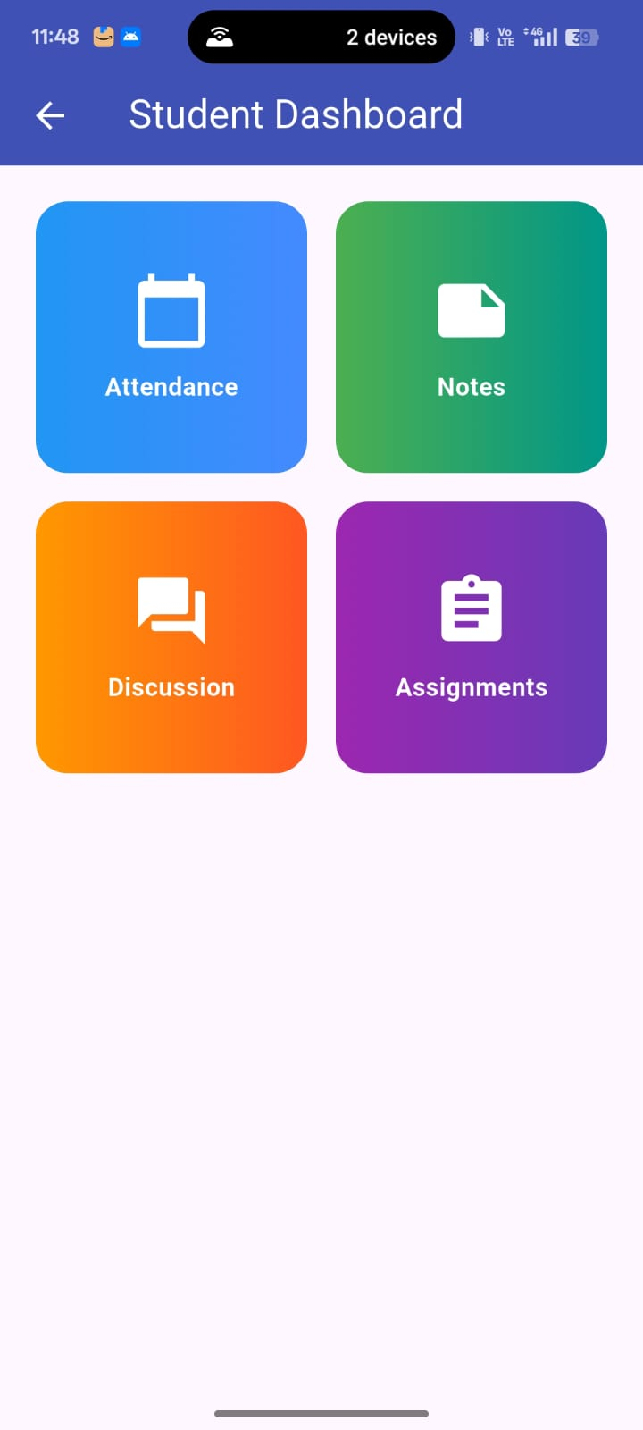
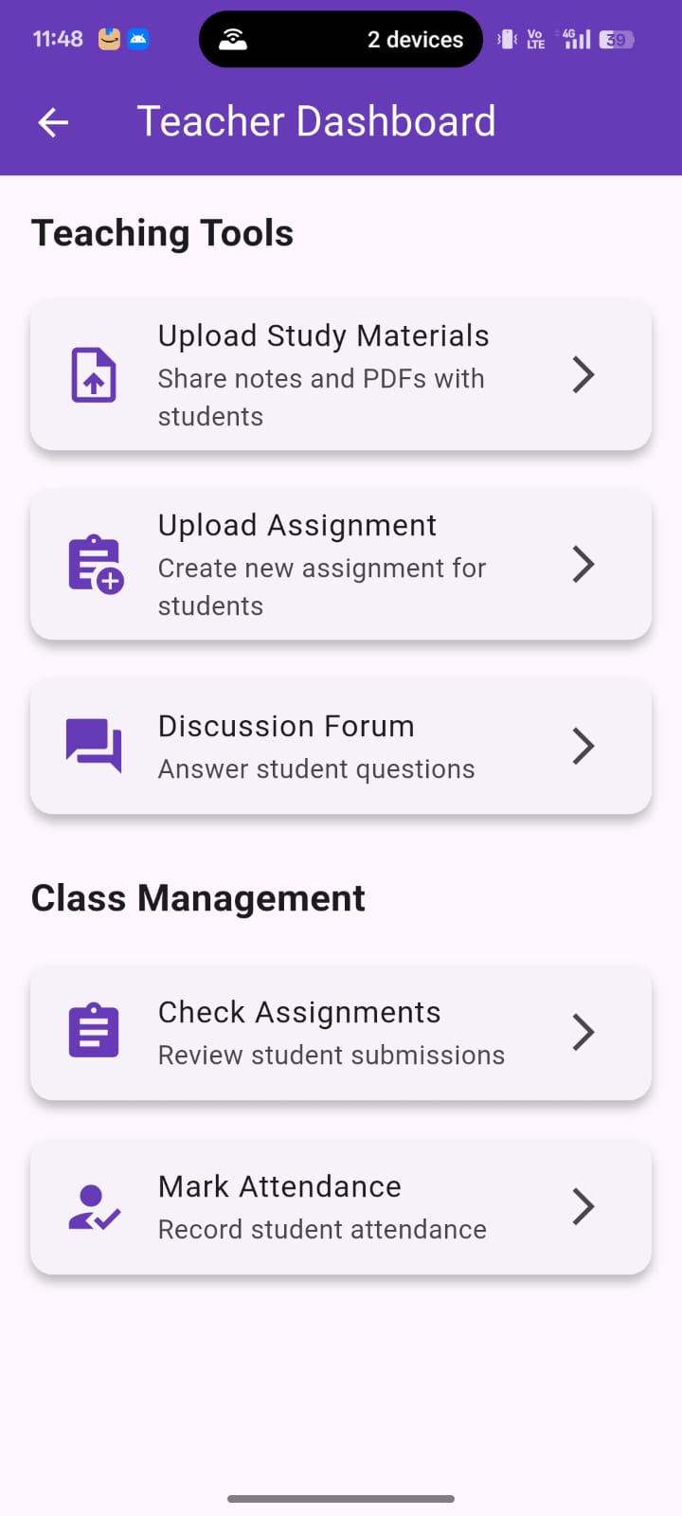
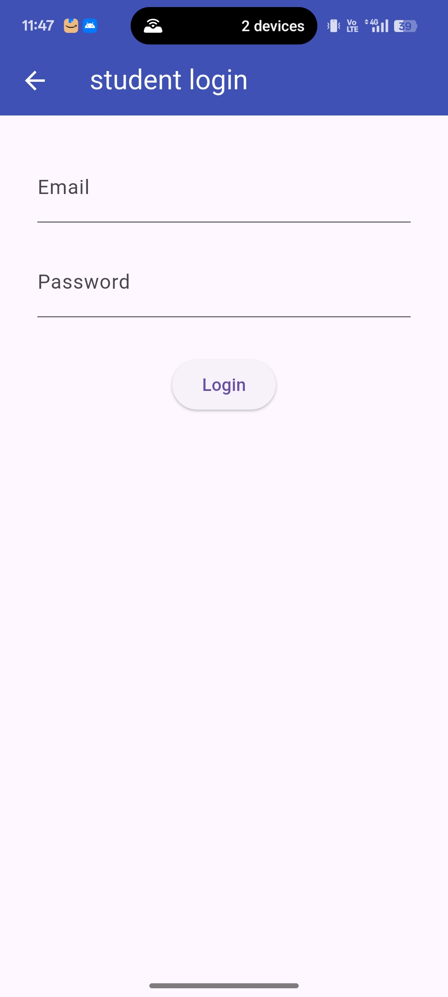

Slide 13
7. Block Diagram ( if applicable)
Login & authentication
Email + password · Role selection (Student / Teacher) · Session management
Role-based router
Student dashboard
Teacher dashboard
Attendance
View records
Notes
Upload / download
Discussion
Ask doubts
Attendance
Manage records
Discussion
Reply to doubts
Assignments
Upload tasks
Shared data layer
In-memory store (Dart Map) · Subject/year-wise organisation · Assignment files
Technology stack
Flutter · Dart · Material UI · GridView · Role-based auth · Local in-memory DB

Slide 14
Thank You...!!

